Slide 1



AI Solutions’ Team
Fawaz & Wafa
Here is where beyond the future begins

Slide 2
Contents:
01
Introduction
05
Business Opportunity
02
Vision
06
Risk Management
03
Project Plan
07
Financial Projections
04
Technical Feasibility
08
Conclusion

Slide 3

Introduction
AI Solutions
Saudi Arabia’s security market is expanding rapidly due to Vision 2030 initiatives, smart city projects, and increasing regulatory requirements, creating strong demand for secure, AI-powered cloud-based VMS solutions.

Slide 4

Vision
Our startup aims to empower private companies with cutting-edge AI solutions, enhancing efficiency, security, and decision-making.
To have the opportunity to expand our impact by collaborating with government sectors, AI-powered solutions that enhance public services, security, and smart governance.
Our goal: To become a strong trusted leader in AI, bridging the gap between private innovation and public sector transformation.

Slide 5
Project Timeline
01
02
03
04
(3 months): Market research, feasibility study, cloud provider selection
(5 months): System development, AI implementation, integrations
(2 months): Testing, cybersecurity compliance
(2 months): Pilot deployment, performance optimization
05
(3 months): Full-scale launch, marketing, expansion

Slide 6

Technical Feasibility
An AI-powered camera works by using smart algorithms to analyze video footage in real time.

Slide 7
Technical Feasibility
Private Cloud Infrastructure
STC Cloud, Mobily Cloud, Aramco Cloud
Integration
Compatible with CCTV (closed circuit television) hardware, IoT (internet of things) devices
AI Features
Object detection, facial & license plate recognition, anomaly detection
Optimization
Edge computing for real-time analytics

Slide 8
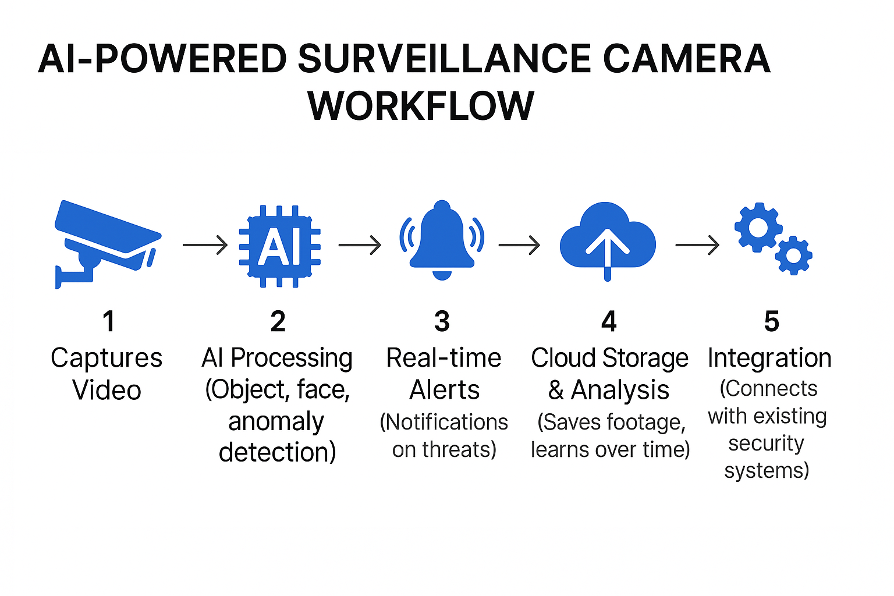
Technical Feasibility

Slide 9
Business Opportunity
Market Size
Saudi Arabia’s surveillance market projected to grow at 10.5% CAGR (2023- 2030).
Global AI in surveillance market to reach $15 billion by 2025.
ns
Enterprise Security
Smart City Integrations
Law Enforcement
Transportation Security

Slide 10
Risk Management
Challenges & Solutions
Growing demand for scalable, secure, and intelligent surveillance solutions.
Real-time object detection, facial recognition, and anomaly detection.
Legacy systems lack AI capabilities and are not cloud-ready.
Scalable, secure, and regulatory-compliant.
Increasing regulatory requirements for data privacy and cybersecurity.
Compatible with legacy cameras and IoT devices.

Slide 11
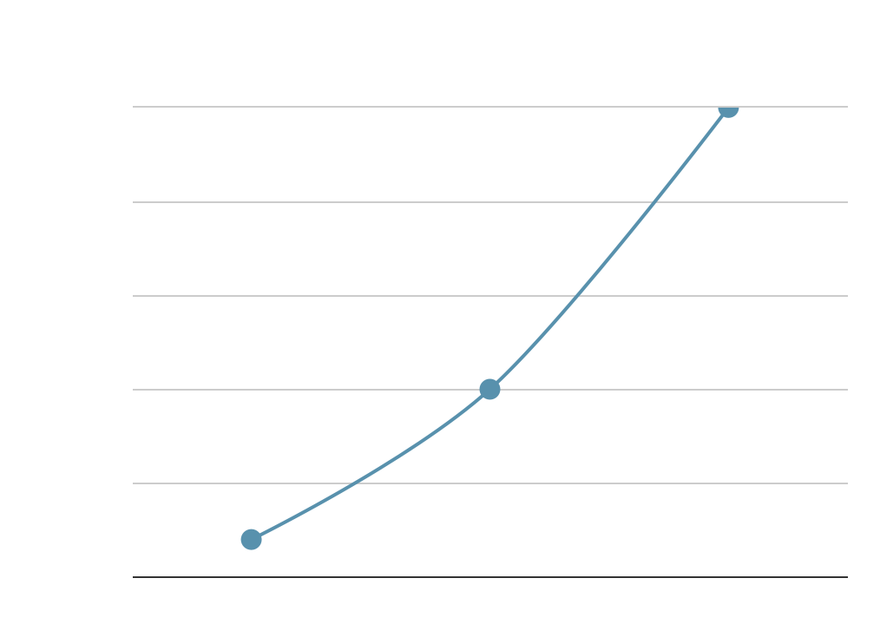
Financial Projections

Slide 12
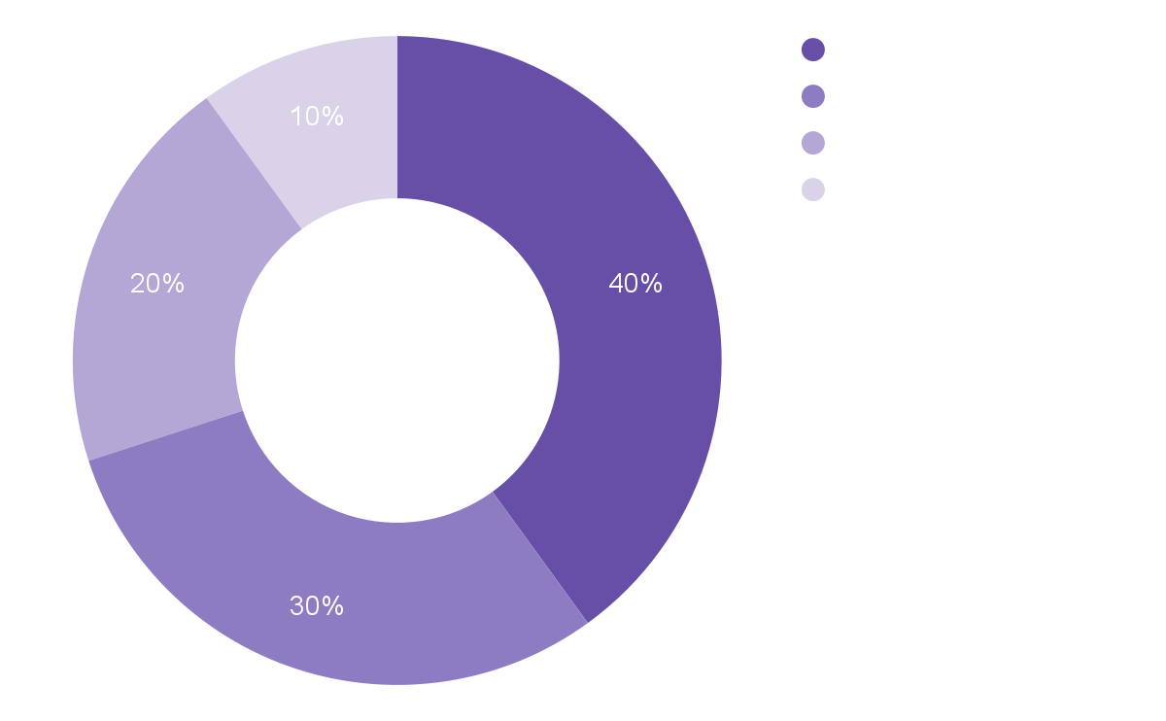
Budget Allocation

Slide 13
Conclusion
Strong market potential for AI-powered private cloud Video Management System.
Addressing security, efficiency, and scalability needs.
Aligns with Saudi Vision 2030 & digital transformation.
Structured project plan for successful deployment.

Slide 14
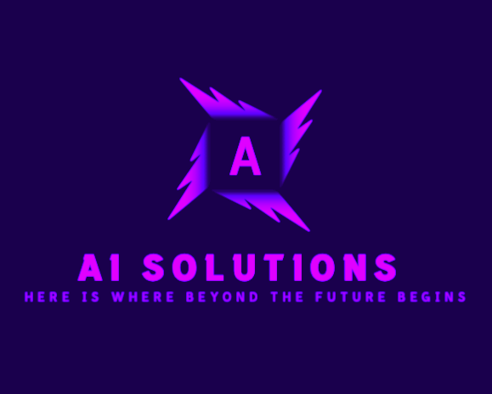
Presented By:
AI Solutions’ Team
Fawaz & Wafa
Thank You

